Slide 1
The Curator
Dodo_Down presents

Slide 2


Slide 3
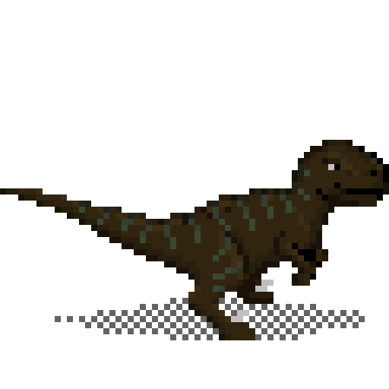
A simple pixel art shooter/puzzler set across the ages

Slide 4

As ‘The Curator’ you are tasked with retrieving artifacts from throughout time for a museum in the future.

Slide 5

Time travel allows an unlimited variety of level themes.

Slide 6

Simple controls!

Slide 7
Pixel Art

Slide 8


Production cycle

Slide 9

Who is it for?

Slide 10
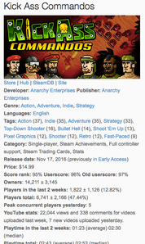
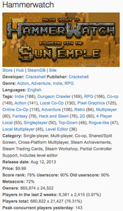
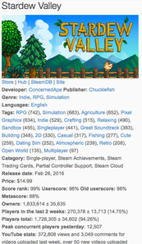
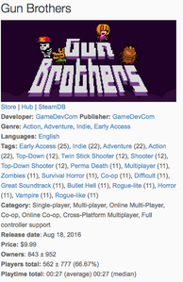
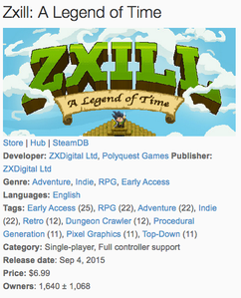
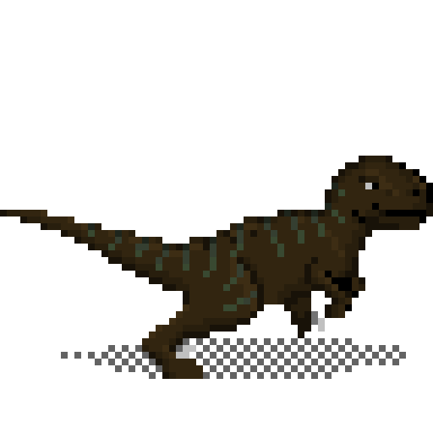
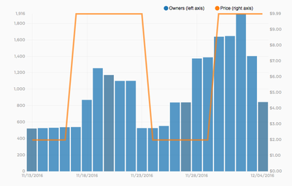
Figures and images courtesy of Steam and Steamspy

Slide 11
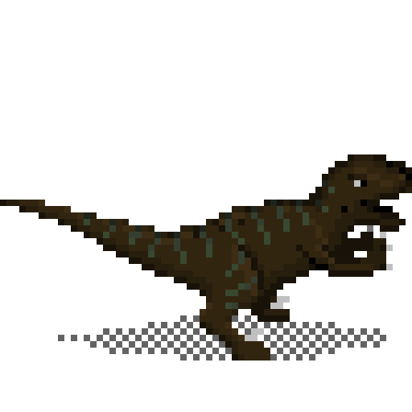
Live demonstration

Slide 12
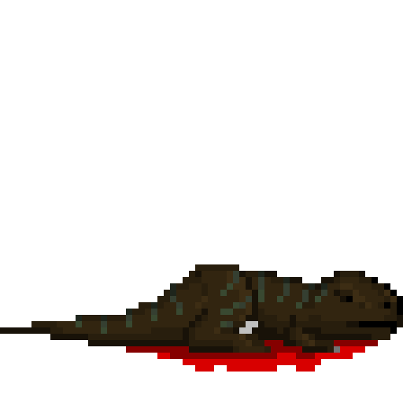
¿Questions?

